Slide 1
JCM
OSCE (suggested answer)
AHNH
7th January 2015

Slide 2
Case 1

Slide 3
M/23
CC
  Fever/sore throat/jaundice 1 week
  Attended A&E 1 week ago
  No travel history
  Good past health

Slide 4
PE
  Jaundice
  Bilateral cervical LNs
  Exudative tonsillitis
  No stigmata of CLD
  Abdomen and chest NAD

Slide 5
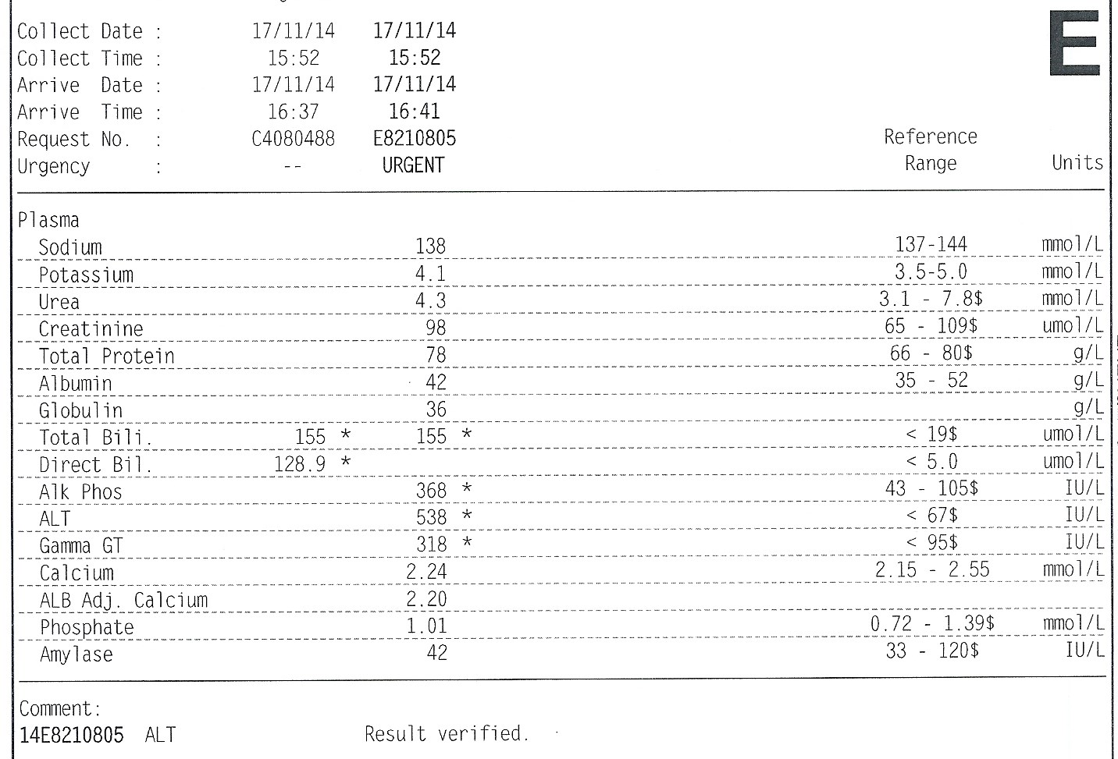

Slide 6
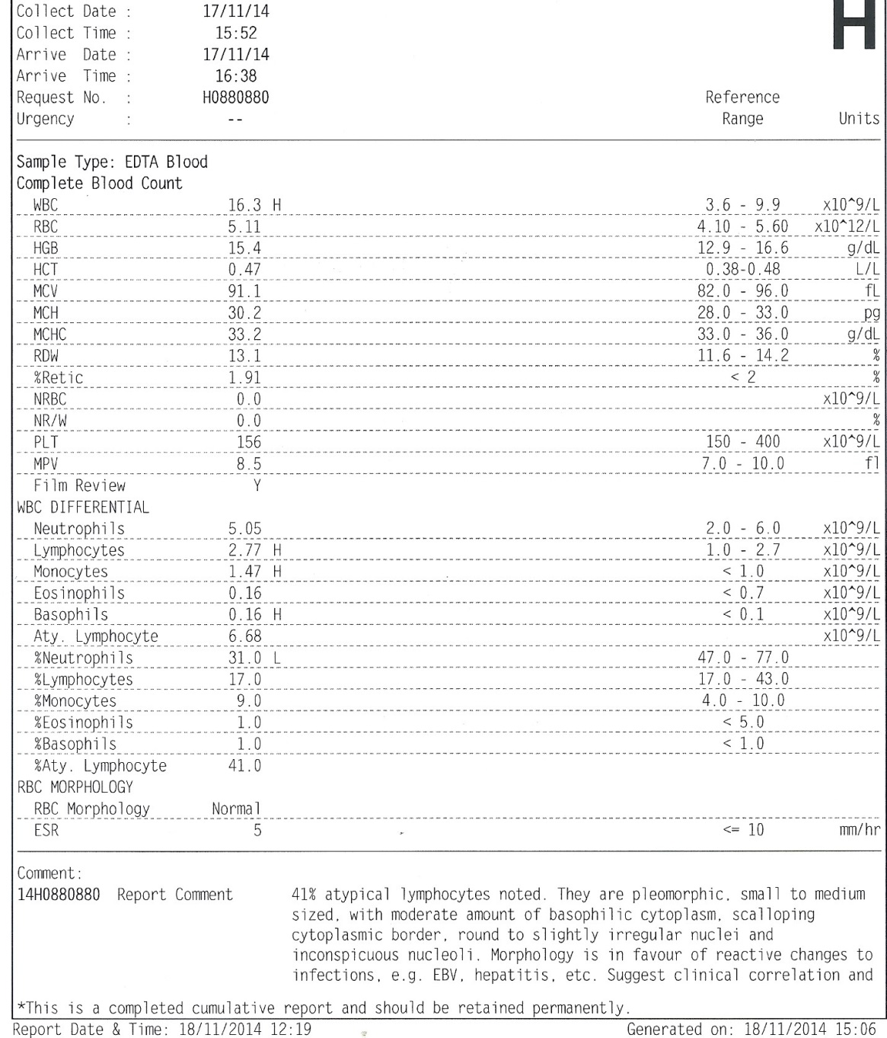

Slide 7
Give one diagnosis to account for the clinical findings.
  Infectious mononucleosis
Suggest 3 other differential diagnoses.
  Hepatitis
  Lymphoma
  Leptospirosis
  Wilson disease

Slide 8
Name the blood test to confirm the diagnosis.
  Monospot test
Give 3 complications of the condition.
  Airway obstruction
  Encephalitis
  Myocarditis
  Splenic rupture
  Pancreatitis
  Acalculous cholecystitis

Slide 9
What is the treatment for the condition?
  Supportive
  Corticosteroid for severe complications

Slide 10
Case 2

Slide 11
M/78
DM/HT
Admitted med for chest pain 5 days ago
Started on Aspirin
Pending private CTA
Sudden collapse in street 2 days after discharge
BP 130/68 P 120 SpO2 74%
GCS E4V1M5
CXR unremarkable

Slide 12
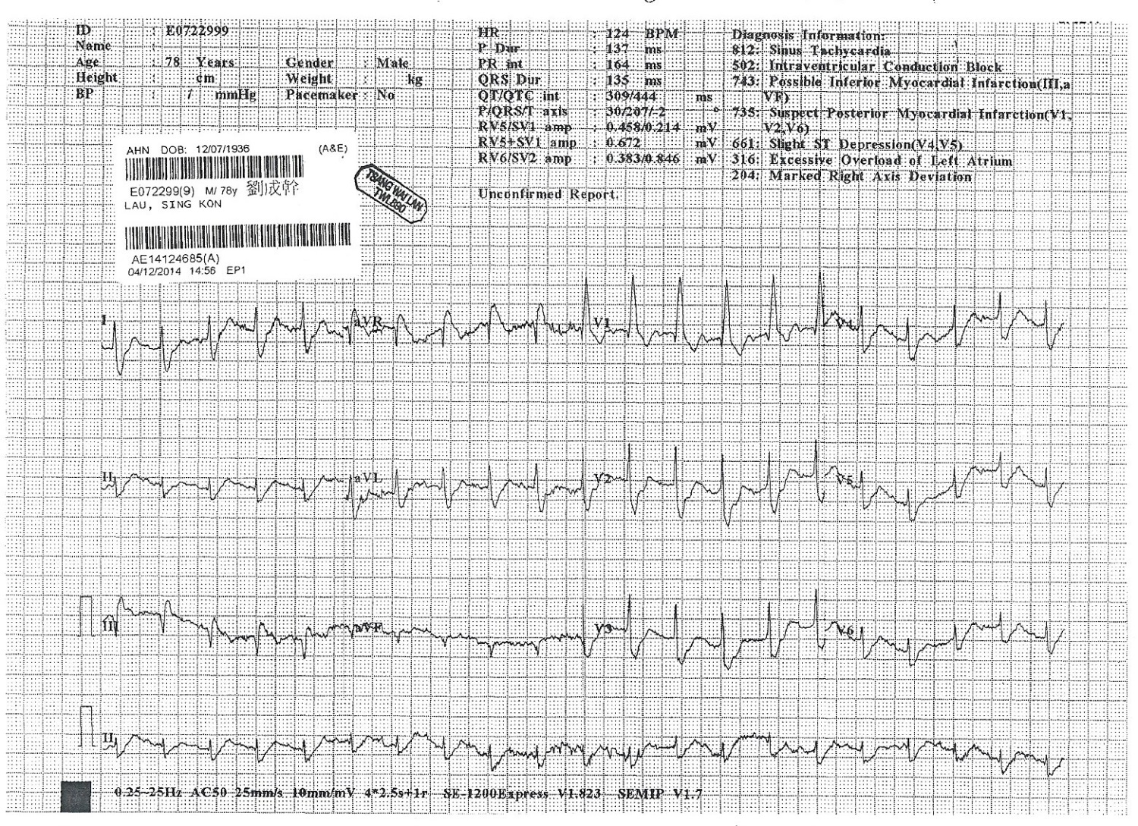

Slide 13
Give 3 descriptions of the ECG.
  Sinus tachycardia
  RAD
  RBBB
  S1Q3T3

Slide 14
The patient is stabilized with endotracheal intubation and mechanical ventilation at A&E.

Slide 15
What is the investigation of choice?
  CT thorax
What are the treatment options?
  Anticoagulation
  Thrombolysis
  Embolectomy
  Vena cava filter

Slide 16
Case 3

Slide 17
M/63
NPC with RT 6 years ago
CC
  Dizziness and vomiting for 3 days
PE
  15/15
  Dehydrated
  Respiratory/CVS/CNS/Abdomen NAD

Slide 18
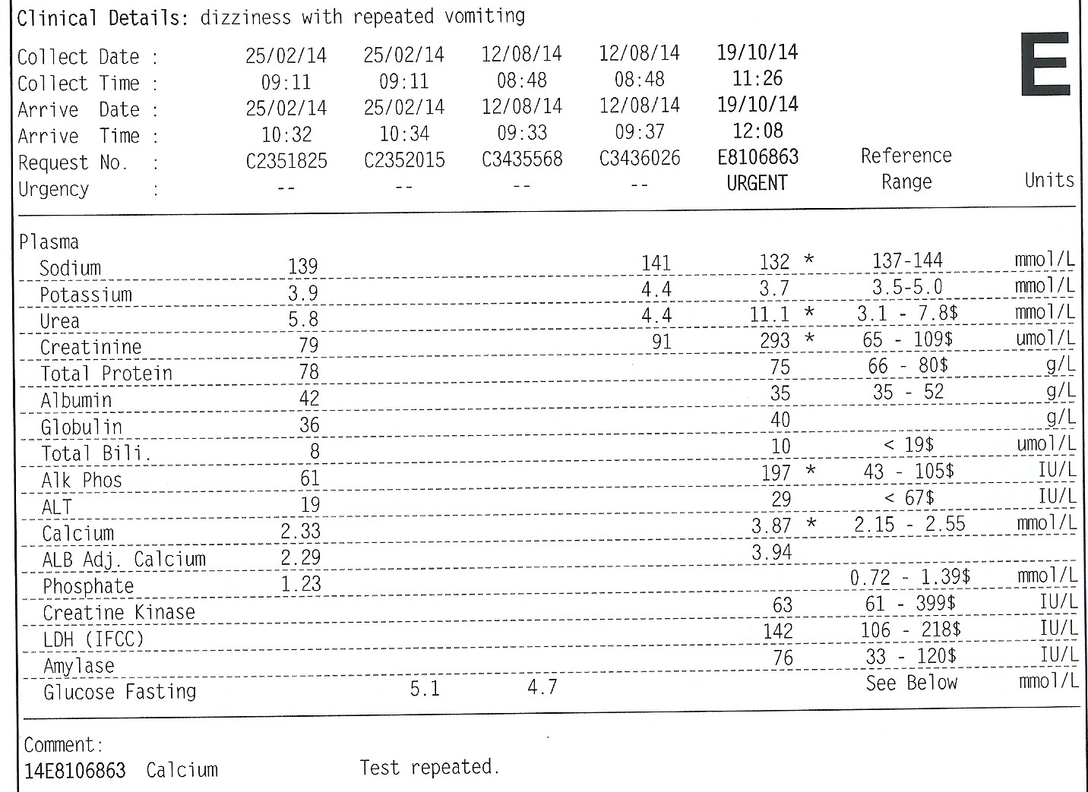

Slide 19
What is the clinical diagnosis?
  Hypercalcaemia

Slide 20
Suggest 3 causes which can give rise to the condition.
  Malignancy
    Parathyroid hormone related protein
    Bone metastasis
  Primary hyperparathyroidism
  Ca++ overdose
  Granulomatous disease

Slide 21
What are the treatment for the condition?
  Rehydration
  Loop diuretic (after rehydration)
  Calcitonin
    4IU/kg IM/SC Q12H
  Bisphosphates
    Pamidronate 90mg in 500ml NS over 4 hours IV
    Zoledronic acid 4mg in 100ml NS over 15min IV
  Dialysis

Slide 22
Case 4

Slide 23
M/62
HT/pAF/IHD
On aspirin etc
Sudden dense right side weakness for 1 hour
BP 167/88 P80
GCS E4V1M5

Slide 24
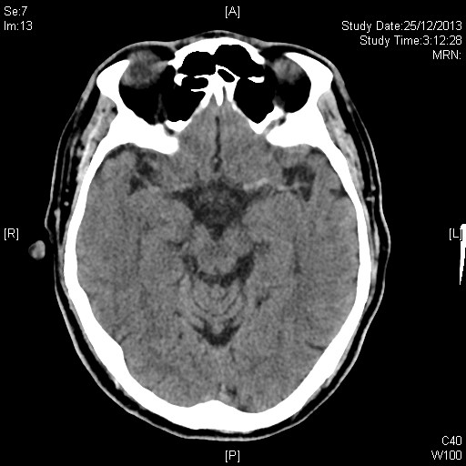

Slide 25
Name the radiological sign present.
  Dense MCA sign
Give 3 other CT signs which may be present for the condition.
  Hypoattenuation
  Insular ribbon sign
  Obscuration of the lentiform nucleus, or blurred basal ganglia

Slide 26
Give 2 CNS complications of the condition.
  Haemorrhagic transformation
  Malignant MCA syndrome
  Seizure

Slide 27
Case 5

Slide 28
M/23
Fell while playing football
Left wrist pain and swelling

Slide 29
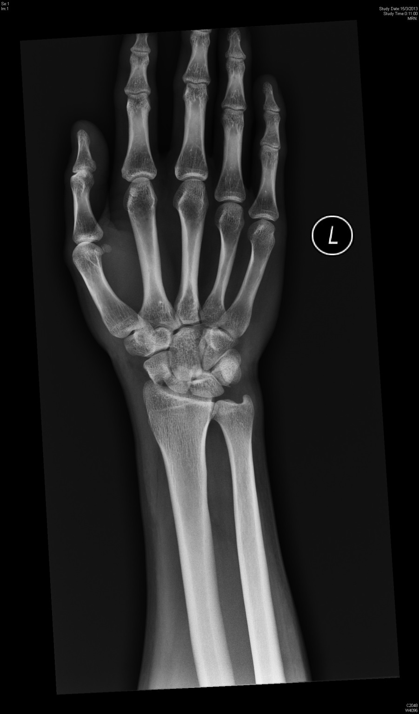

Slide 30
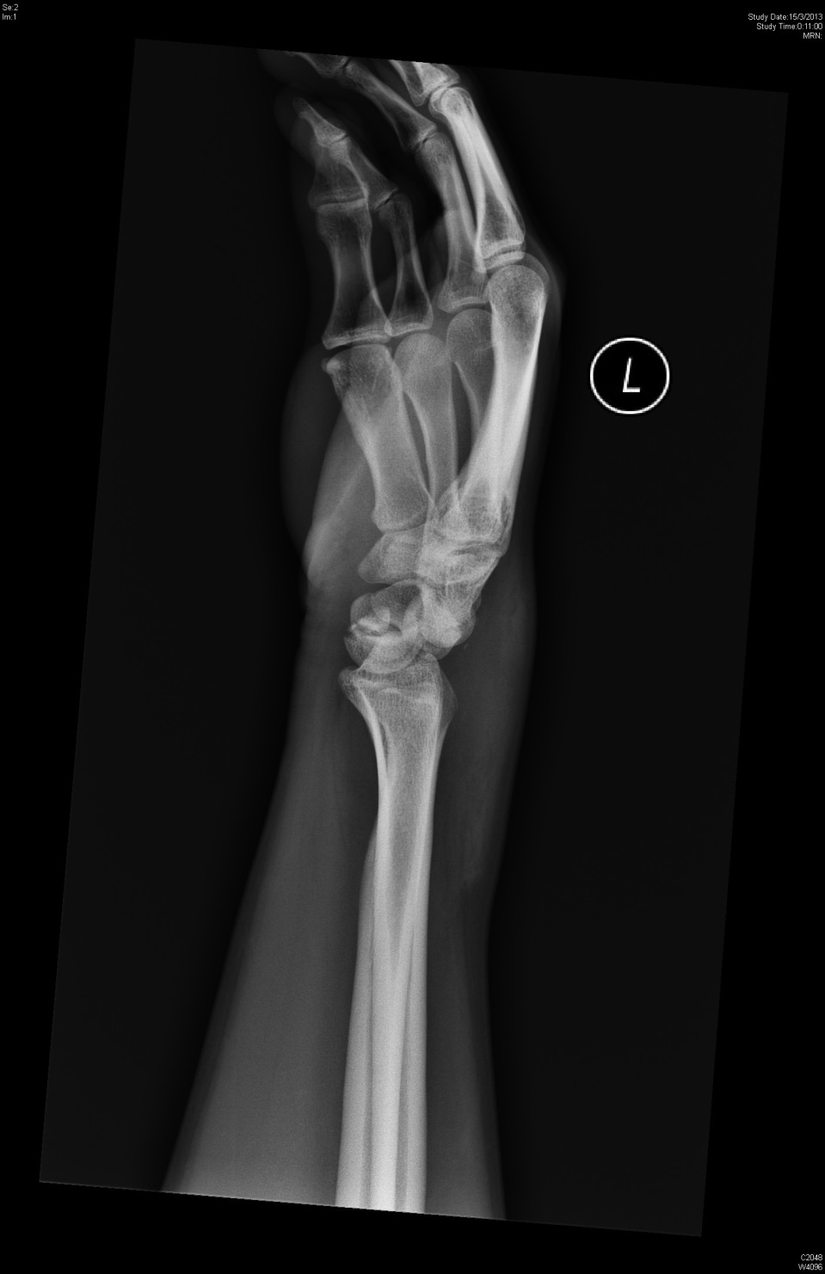

Slide 31
What is the diagnosis?
  Trans-scaphoid perilunate dislocation
What is the management?
  Urgent closed reduction
  Open reduction and internal fixation

Slide 32
Give 4 complications.
  Median nerve injury
  Compartment syndrome of the hand
  Carpal instability
  Scaphoid nonunion/malunion
  Traumatic arthritis
  Late flexor tendon rupture
  Persistent pain/weakness

Slide 33
Case 6

Slide 34
M/45
Rt ear discharge for 2 weeks
Rt side headache/neck pain/diplopia 2 days

Slide 35
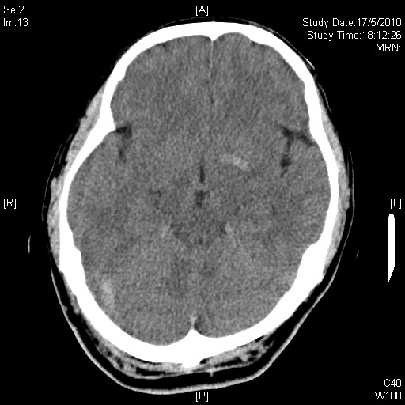

Slide 36
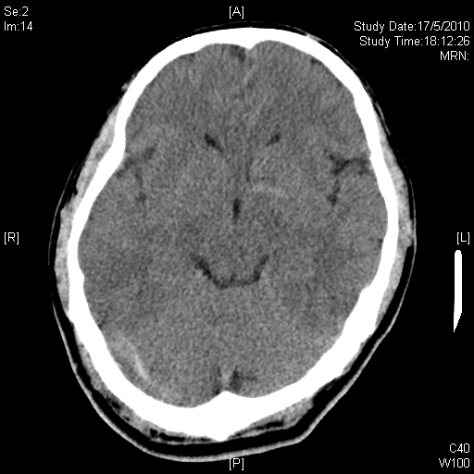

Slide 37
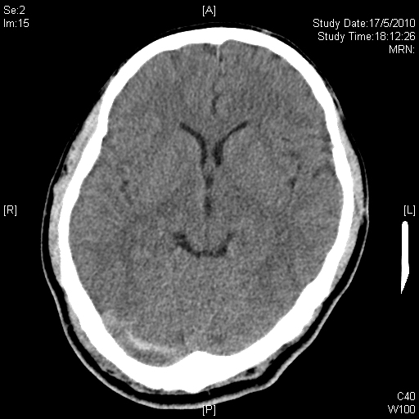

Slide 38
What is the clinical diagnosis?
  Venous sinus thrombosis
What is the investigation of choice to confirm the diagnosis?
  CT venogram
What should be the management?
  Treat underlying mastoiditis
  Anticoagulation

Slide 39
The end

